Slide 1
Mass Storage Structure

Slide 2
Overview of Mass Storage Structure
Magnetic disks provide bulk of secondary storage of modern computers
Drives rotate at 60 to 250 times per second
Transfer rate is rate at which data flow between drive and computer
Positioning time or random-access time or seek time is time to move disk arm to desired cylinder
rotational latency
Head crash results from disk head making contact with the disk surface

Slide 3
Cont..
Drive attached to computer via I/O bus
Busses vary, including EIDE, ATA, SATA, USB, Fibre Channel, SCSI, SAS, Firewire
Host controller in computer uses bus to talk to disk controller built into drive or storage array

Slide 4
Moving-head Disk Mechanism

Slide 5
Disk Structure
Disk drives are addressed as large 1-dimensional arrays of logical blocks
Where the logical block is the smallest unit of transfer
Low-level formatting creates logical blocks on physical media
The 1-dimensional array of logical blocks is mapped into the sectors of the disk sequentially
Sector 0 is the first sector of the first track on the outermost cylinder
Logical to physical address should be easy
Except for bad sectors
Non-constant of sectors per track via constant angular velocity

Slide 6
Disk Management
Low-level formatting, or physical formatting
Each sector can hold header information, plus data, plus error correction code (ECC)
Usually 512 bytes of data but can be selectable
To use a disk to hold files, the operating system still needs to record its own data structures on the disk
Partition
Logical formatting or “making a file system”

Slide 7
Cont..
To increase efficiency most file systems group blocks into clusters
Disk I/O done in blocks
File I/O done in clusters
Boot block initializes system
The bootstrap is stored in ROM
Bootstrap loader program stored in boot blocks of boot partition
Methods such as sector sparing used to handle bad blocks

Slide 8
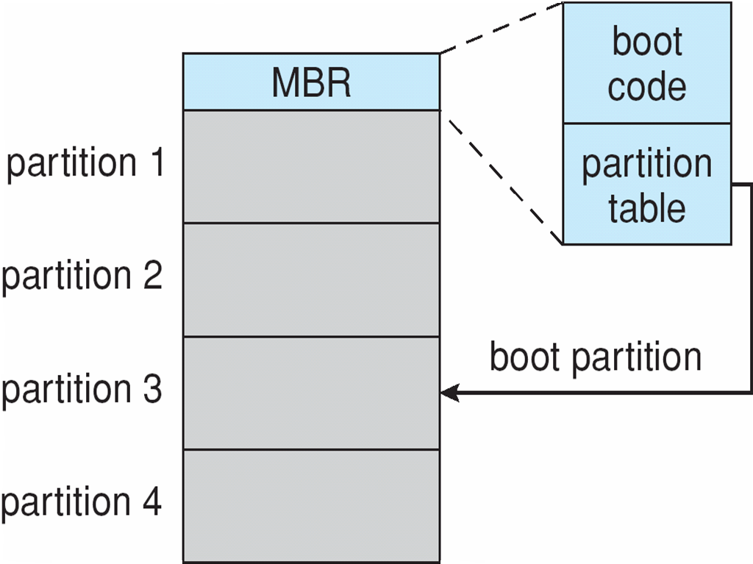
Booting from a Disk in Windows

Slide 9
Disk Scheduling
The operating system is responsible for using hardware efficiently
Minimize seek time
Seek time ≈ seek distance
Disk bandwidth
Disk Access Time = Seek Time + Rotational Latency + Transfer Time
Total Seek Time = Total head Movement * Seek Time

Slide 10
Cont..
There are many sources of disk I/O request
OS
System processes
Users processes
Several algorithms exist to schedule the servicing of disk I/O requests
We illustrate scheduling algorithms with a request queue (0-199)
98, 183, 37, 122, 14, 124, 65, 67

Slide 11
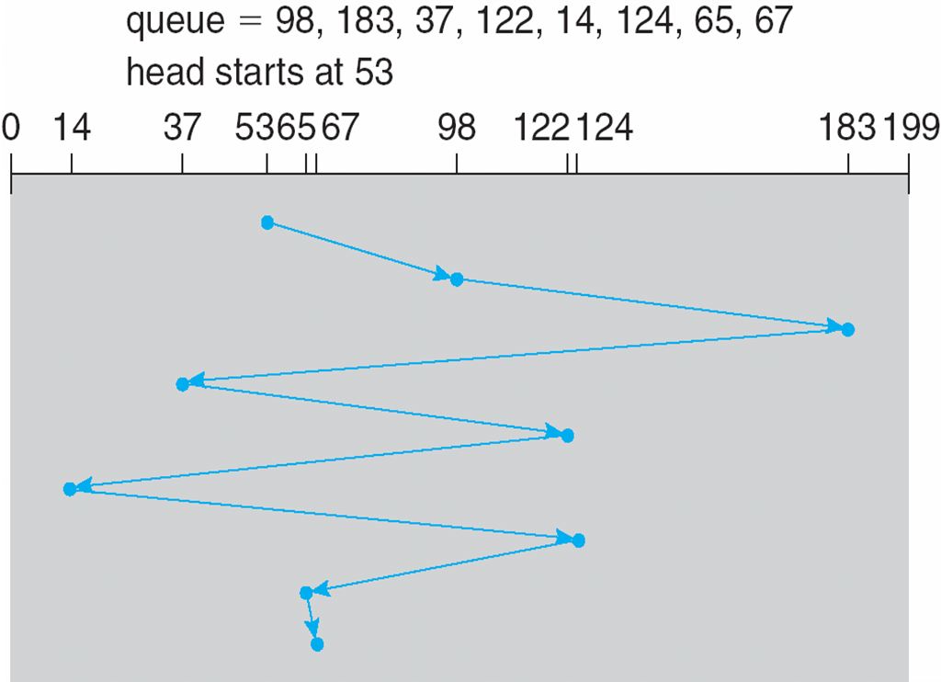
FCFS
Illustration shows total head movement of 640 cylinders

Slide 12
SSTF
Shortest Seek Time First selects the request with the minimum seek time from the current head position
SSTF scheduling is a form of SJF scheduling; may cause starvation of some requests
Illustration shows total head movement of 236 cylinders

Slide 13
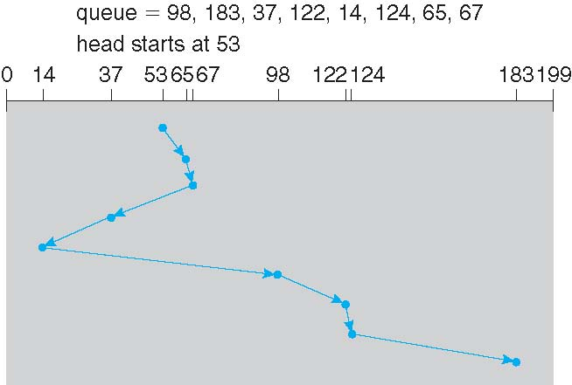
SSTF (Cont..)

Slide 14
SCAN
The disk arm starts at one end of the disk, and moves toward the other end, servicing requests until it gets to the other end of the disk, where the head movement is reversed and servicing continues
SCAN algorithm Sometimes called the elevator algorithm
But note that if requests are uniformly dense, largest density at other end of disk and those wait the longest

Slide 15
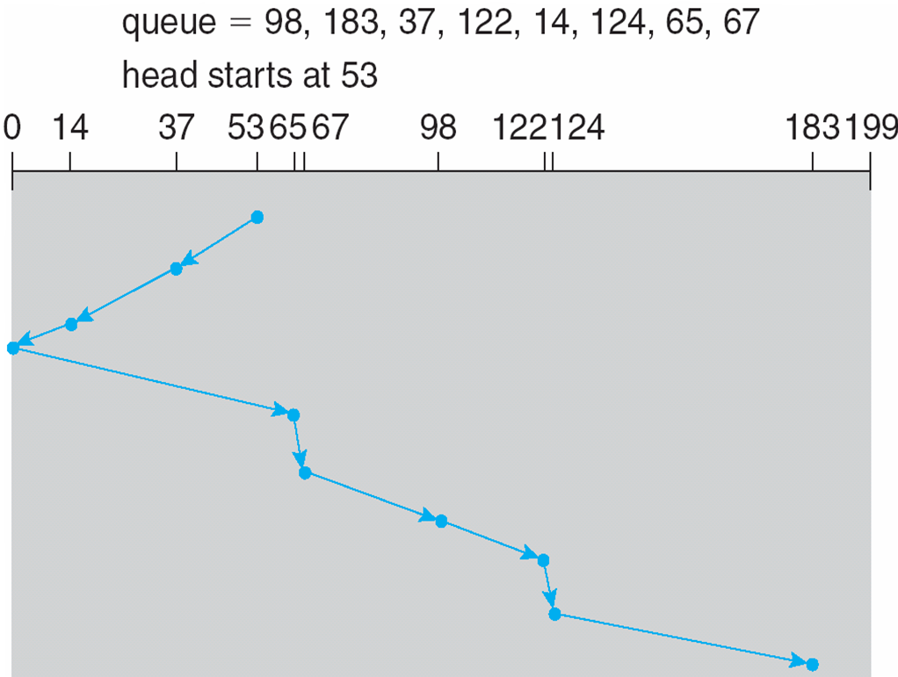
SCAN (Cont.)
= (199-50) + (199-16) = 332

Slide 16
C-SCAN
Provides a more uniform wait time than SCAN
The head moves from one end of the disk to the other, servicing requests as it goes
When it reaches the other end, however, it immediately returns to the beginning of the disk, without servicing any requests on the return trip
Treats the cylinders as a circular list that wraps around from the last cylinder to the first one

Slide 17
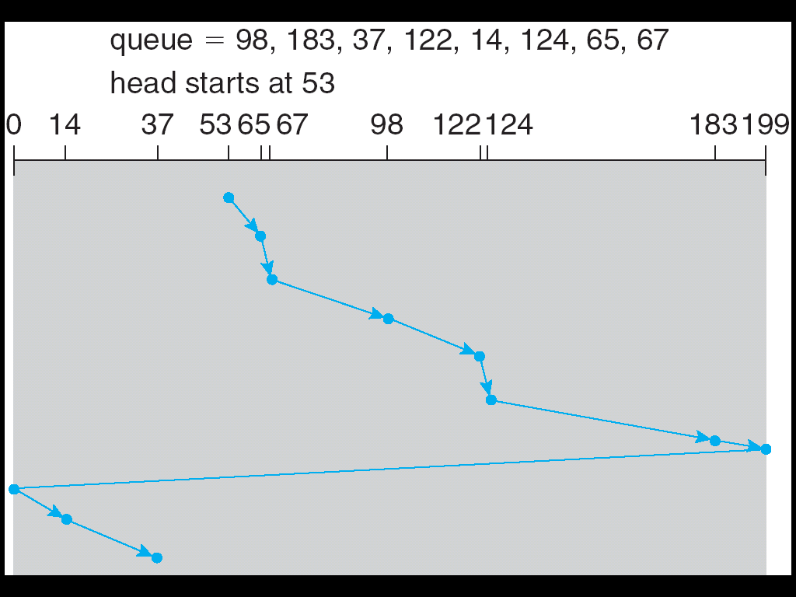
C-SCAN (Cont.)
=(199-50) + (199-0) + (43-0) = 391

Slide 18
C-LOOK
LOOK a version of SCAN, C-LOOK a version of C-SCAN
Arm only goes as far as the last request in each direction, then reverses direction immediately, without first going all the way to the end of the disk

Slide 19
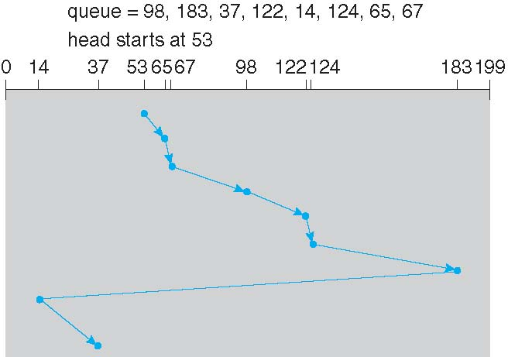
C-LOOK (Cont.)
C-LOOK (Cont.)

Slide 20
Swap-Space Management
Swap-space — Virtual memory uses disk space as an extension of main memory
Swap-space can be carved out of the normal file system, or, more commonly, it can be in a separate disk partition (raw)
Swap-space management
4.3BSD allocates swap space when process starts; holds text segment (the program) and data segment
Kernel uses swap maps to track swap-space use
Solaris 2 allocates swap space only when a dirty page is forced out of physical memory, not when the virtual memory page is first created

Slide 21
Data Structures for Swapping on Linux Systems

